Slide 1
The Narrative Structure

Slide 2
The Narrator
► in every movie, the camera is the primary narrator
First-person narrator
voice-over narration (example or)
direct-address narration (example or /ex)
Third-person narrator someone removed from the story provides info not accessible by characters in the movie
omniscient (unrestricted access to all aspects of the story) (example or 1/or?)
restricted (limits the info given, usually from only one character)

Slide 3
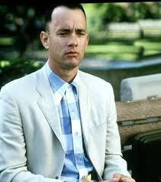
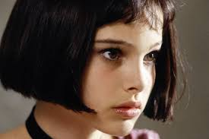
Characters
Film narratives depend on two elements:
a character
pursuing a goal
New and different characters make it possible to have a new take on the same old story
Narrative cannot exist if the character does not have a goal
gives the character something to do
gives the audience a chance to participate/get involved/care about the story

Slide 4
Characters…
Protagonist – the primary character who pursues the goal
usually a hero of some sort
sample lists 1 2 3
as long as protagonist actively pursues goal in an interesting way → viewer will be invested in the pursuit
does not always necessarily have worthy goals: the anti-hero
unsympathetic protagonists chasing less than noble goals (1)

Slide 5
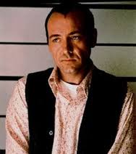
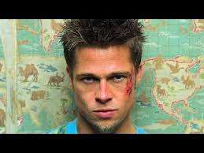
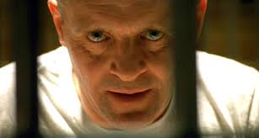
Characters…
Narratives thrive on imperfect characters = imperfections provide obstacles
aka: character flaws
character imperfections/flaws give characters more room to grow

Slide 6
The Basic Narrative Structure:
→ a clearly motivated protagonist
→ pursues a goal
→ encounters obstacles
→ a clear resolution

Slide 7
Narrative Structure: The Organization in Three Acts
Most narratives can be broken into three basic parts:
first act sets up the story
second (and longest) act develops the story
third act resolves it

Slide 8
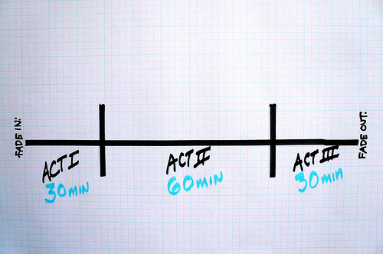
Organizing The Story
For a 120 minute film:

Slide 9
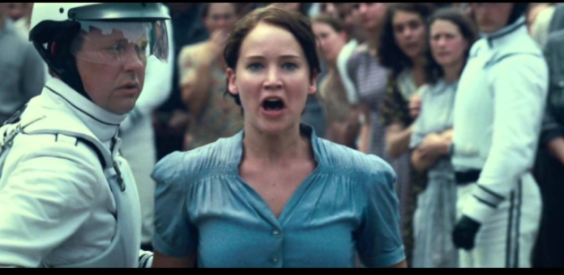
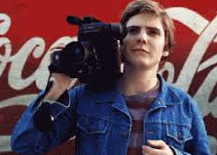
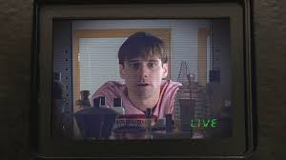
First Act:
Tells what kind of story it is by establishing the “normal world”
lays out rules of the universe we are about to experience
a hook (ie: Indiana Jones)
characters are established, something their current situation
Inciting Incident – something will occur to change the normal world and set protagonist on pursuit/mission/quest…
presents the character with the goal to drive the narrative
most are easy to spot
some goals may shift later in the story
Star Wars: fist to rescue princess, then the take on Death Star

Slide 10
Second Act:
Second act is the story, or the pursuit of the goal (ie: Will Dorothy ever get back to Kansas?)
the want to learn ‘what and how’ keeps the viewer engaged
we want the answer to be yes – but ironically, if goal is quick/easily attained, the story is over: need conflict
the story depends on obstacles
Antagonist; nature of is varied, not always a villain, sometimes not human (the rock in 127 Hours)
the stakes need to rise – deeper we get in the story, the greater the risk to the protagonist
building toward a peak (rising action) building toward a turning point
at the peak, the goal is in its greatest jeopardy

Slide 11
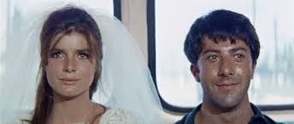
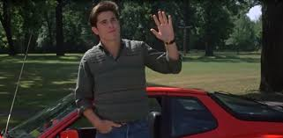
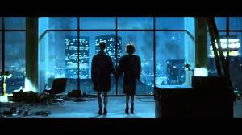
Third Act:
Climax and solution, loose ends tied up
the climax comes when the protagonist faces this major obstacle – it’s the most impressive event in movie
best stories have an unexpected solution
resolution/dénouement

Slide 12
Structure Analysis
The King's Speech
The Matrix
E.T.: The Extra-Terrestrial
Avengers
Plot Points
Another explanation

Slide 13
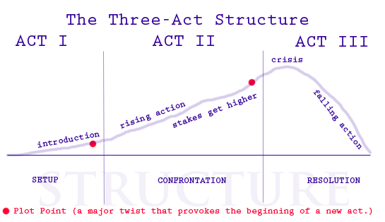
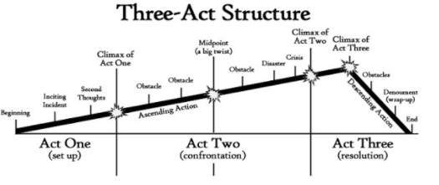
Three Act Structure: try it
Monday & Tuesday the class will be doing a Premiere Pro tutorial. If you do not need this tutorial, please let me know – I will come around and check in with those who indicated they had some experience.
With a partner or your table group…
Come up with a movie you have all seen (AND remember)
Divide it up into acts.
include inciting incident
list/explain obstacles
is there a climax event (where goal is in most jeopardy)?
resolution?

Slide 14
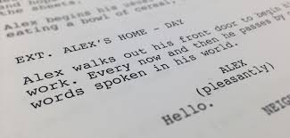
The Screenwriter
Builds narrative structure and creates every character, action, line of dialogue and the setting
done with fewest lines possible
Each page of script represents ~ one minute of screen time
Must create compelling stories, engaging plots, and fascinating characters, AND must understand what is marketable

Slide 15
Elements of Narrative
Story v. Plot
stories may be common (Cinderella) but plots can change (Into the Woods, Ela Enchanted, Pretty Women)
Order
bringing order to the events is one of the most fundamental decisions filmmakers make
with so little time, must decide what to include/not include
eg: movies made from books…
plot can be manipulated so events are presented in non-chronological order (eg: Citizen Kane, Memento), yet…
most narrative films follow traditional chronological order

Slide 16
Duration
Story duration
amount of time the implied story takes to occur
the period covered by all the events that you see or know about
Plot duration
elapsed time of the events within the story (the time of the plot)
Screen duration
movie’s running time
Balancing the three is complex (remember, screenwriters do this with as fewest lines as possible)
Citizen Kane:
story duration: 70+ years
plot duration: ~ 1 week
screen duration: 1hr, 59 min.

Slide 17
Surprise v. Suspense
surprise: being taken unawares, can be shocking and emotional response to it is generally short-lived
there are no repeat surprises; can be surprised the same way only once
suspense: more drawn-out experience, involves the audience
Hitchcock

Slide 18
Come up with a couple story ideas.
write ideas on a new piece of paper (you will turn this in on Monday)
need ideas?
chat with your table people; but each needs their own two or three ideas
Cinefix 10 Best Structured Films

Slide 19
Ninja: https://vimeo.com/37888100

