Slide 1
Post-World War I Film in Europe
German Expressionism
1919 -1933
Soviet Montage
~1924 -1930
French Avant-Garde
1918 -1930

Slide 2
1919-1933 German Expressionism
Presentation by Chris Schloemp

Slide 3
Historical Background
1919
Weimar government wanted to revitalize the film industry
give Germany new image
subsidized film – allowed Germany to compete with other countries
ranked 2nd (to Hollywood) technically, in influence, and in popularity by mid-20s

Slide 4
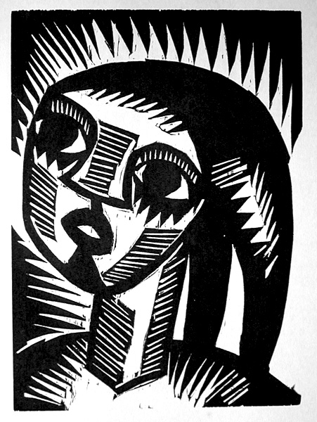
By 1933…
Control tightened over the industry
many German film makers left for the US

Slide 5
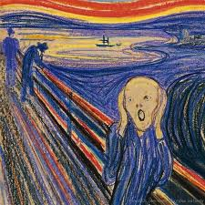
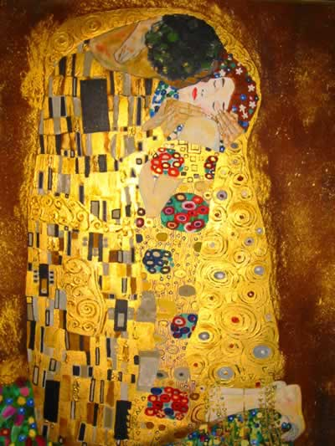
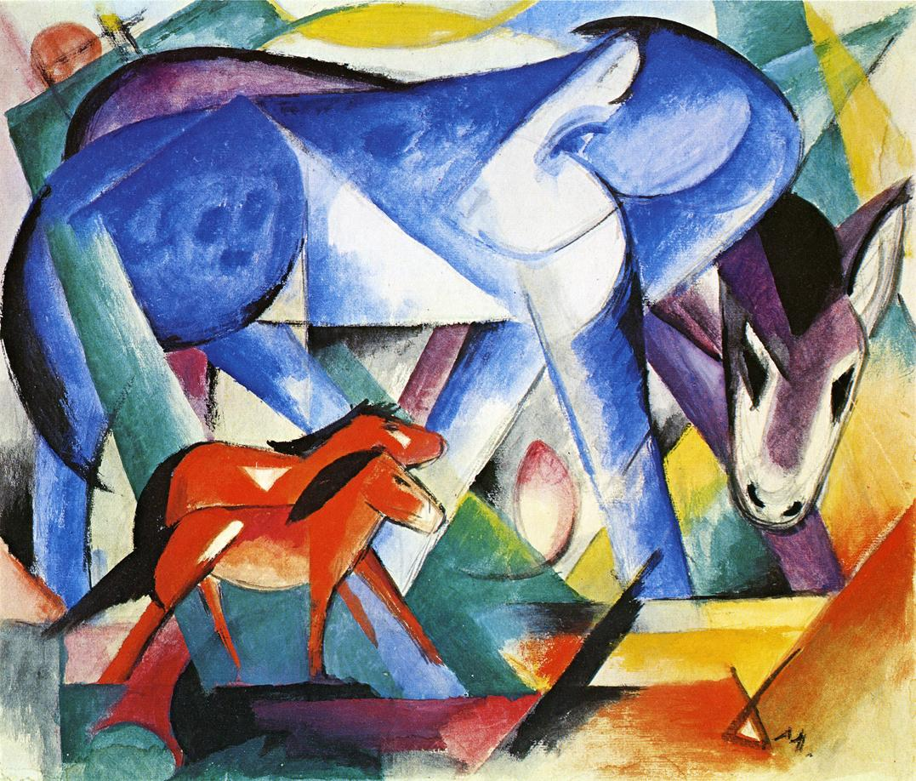
Artistic Background
A work of art where the representation of reality is distorted in order to convey the “inner vision”
the “essence of things,” rather than the way things appear
Relied on symbolism and artistic imagery
Notes:
Friedrich Nietzsche

Slide 6
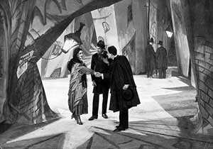
Key Features of German Expressionistic Film
Emphasis on shapes, forms, and patterns
distorted and/or exaggerated settings
use of oblique angles and nonparallel lines
Hypnotic and nightmarish worlds
Unnatural costumes, hairstyles, and make-up
Highly stylized acting
Most important aspect:
Mise-en-scene

Slide 7
Mise-en-scène…
French term, literally: "put in the scene."
For film, refers to almost everything that goes into the composition of the shot:
framing,
movement of the camera and characters,
depth, proximity, size and proportions of the places and objects,
lighting,
set design and general visual environment,
even sound.
The overall look and feel of a movie, the sum of everything the audience sees, hears, and experiences while viewing the movie.
Notes:
Mise en scene refers to all the objects and characters in a particular frame. More specifically, it refers to the composition of the frame. When you use the term mise en scene, you are discussing where the composer or director has placed all the elements of the scene within the frame.

Slide 8
Key Films
The Cabinet of Dr Caligari (1920)
Nosferatu (1922)
Metropolis (1927)

Slide 9
The Cabinet of Dr. Caligari (1920)
Director: Robert Wiene
Stylized sets: distorted buildings painted on canvas backdrops
Little attempt at realistic performances by actors
jerky, dance-like movements
Begins the horror-film genre
Ch 2 – fair (or)

Slide 10
Nosferatu (1922)
Director: F.W. Murnau
Experimenting with the language of film
World is distorted and stylized
Extreme camera angles and elongated shadows
Special effects: superimposition and time-lapse photography
Reinterpretation of Bram Stoker's Dracula (1897)
in a post-WWI world
Nosferatu

Slide 11
Metropolis (1927)
Director: Fritz Lang
Commentary on the political situation in Germany
economic and political aftermath of Germany’s defeat
hyperinflation, revolts on the streets and a general sense of anxiety and dissatisfaction with the ruling powers
And a warning of where Germany was heading
Dystopian
dangers inherent in capitalism and industrialization
Metropolis

Slide 12
Tim Burton and German Expressionism

