Slide 1
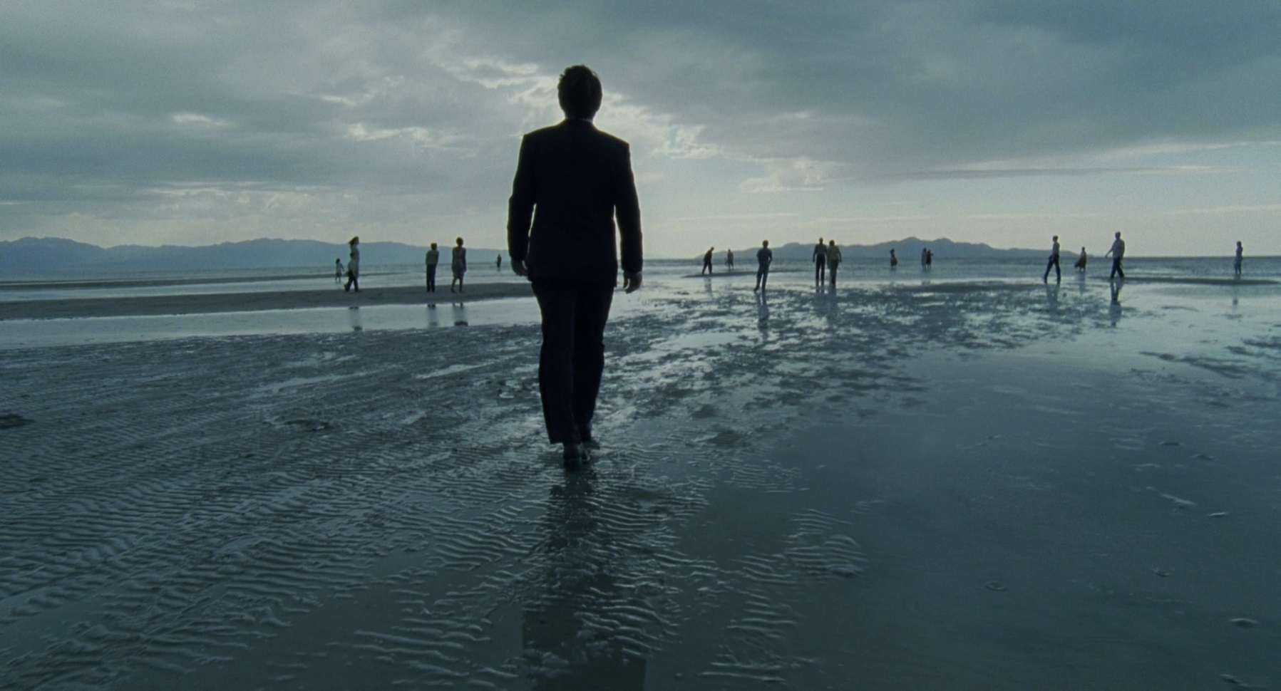
(2017, 2018) Cinematography

Slide 2
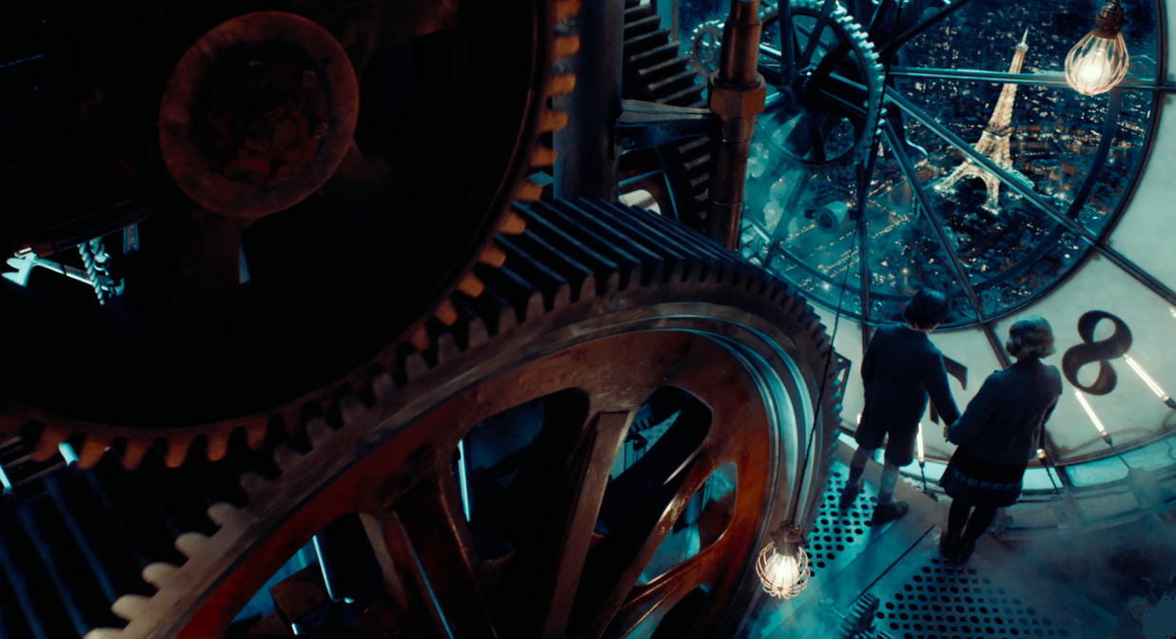
Definition
“the process of capturing moving images on film”
Cinematographer = Director of Photography or DP
Makes every creative choice related to composition, lighting, and camera motion—anything that audiences can see in a given shot
depth-of-field to lighting the set to the positioning of people and objects within the frame to choosing the lenses and film stock
One of the director’s closest collaborators
DPs often accompany directors from project to project

Slide 3
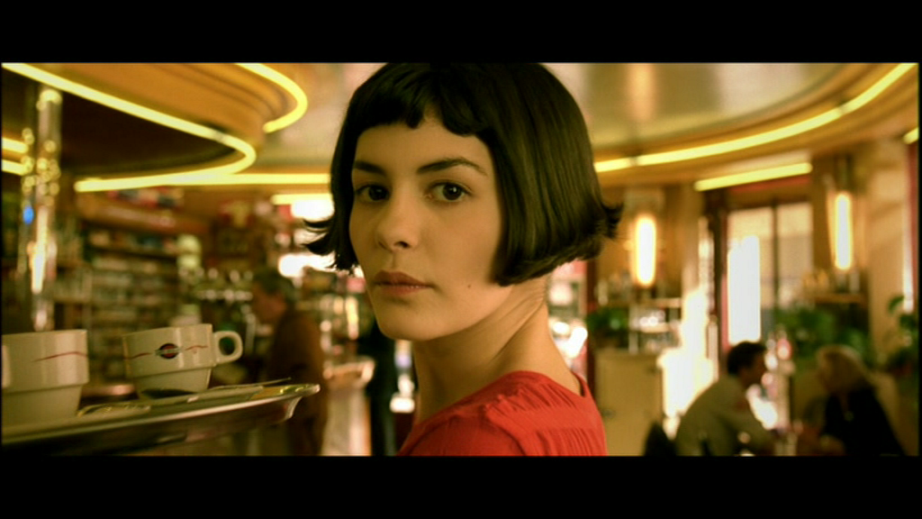
Cinematography v. Mise en Scene
Mise en Scene refers to “what is filmed”
Cinematography refers to “how it is filmed”
Some elements – like lighting, can be both

Slide 4
Elements of Cinematography
Framing and Composition
shot types
camera angles
depth
camera movement
aspect ratio
lighting*
Camera and exposure choices, film stock and lenses*

Slide 5
Framing and Composition: Shot Types
extreme long (ELS)
long (LS)
medium (MS)
close-up (CU)
extreme close-up (ECU)

Slide 6
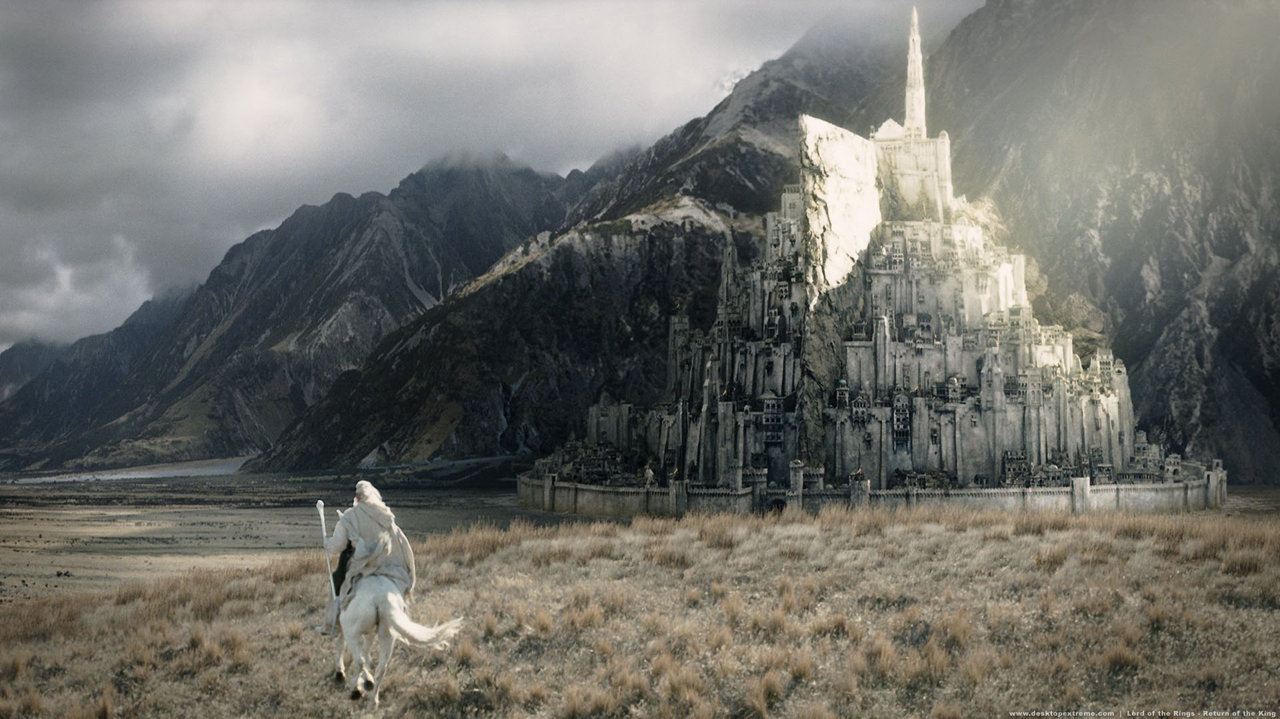
Shot Types (Framing and Composition)
Extreme Long Shot
aka:
used when/for:
setting the scene – the what/where

Slide 7
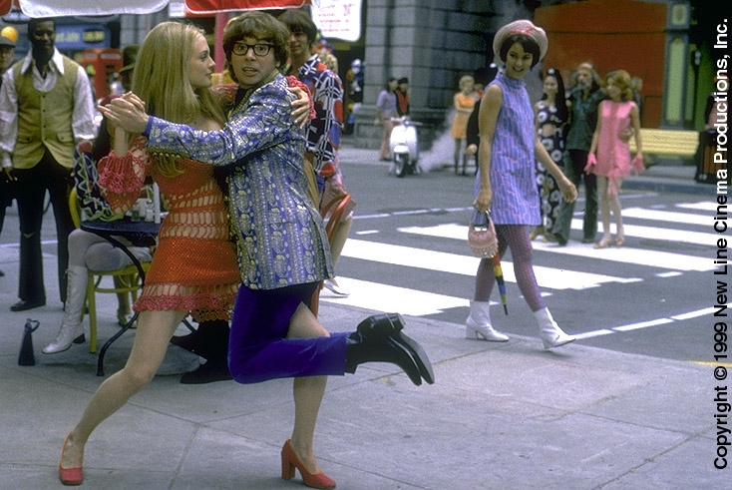
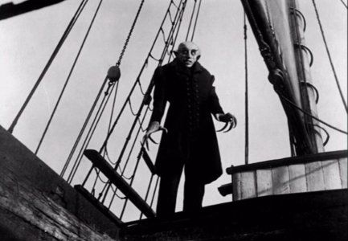
Shot Types (Framing and Composition)
Long Shot
used when/for:
also estb, but for characters, etc.

Slide 8
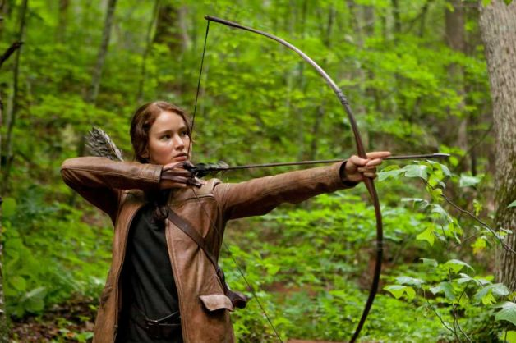
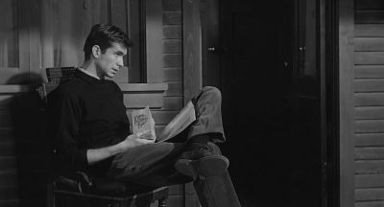
Shot Types (Framing and Composition)
Medium Long Shot and Medium Shot
used when/for:
most common; dialog…

Slide 9
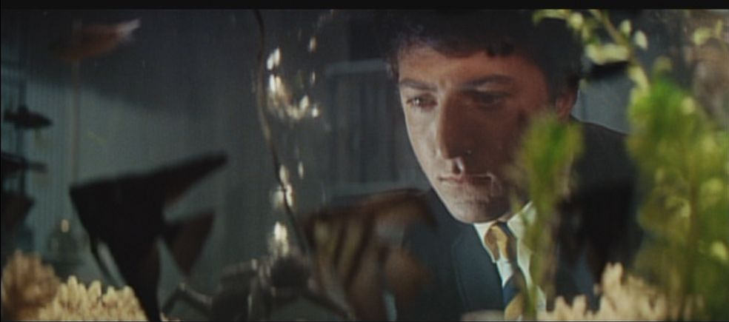
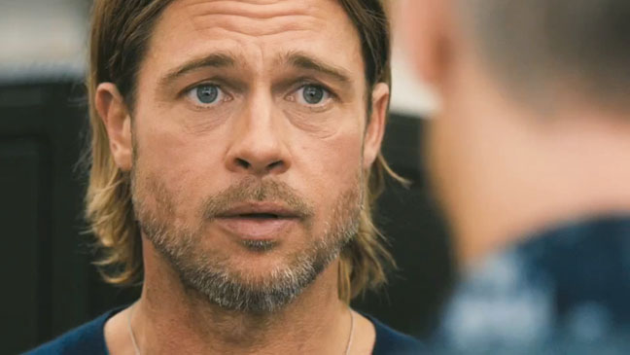
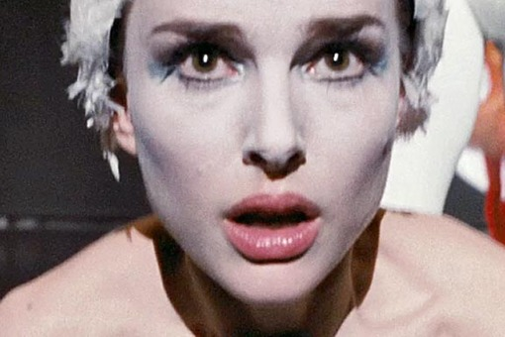
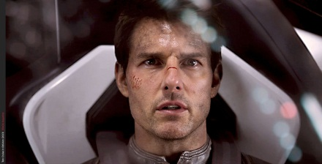
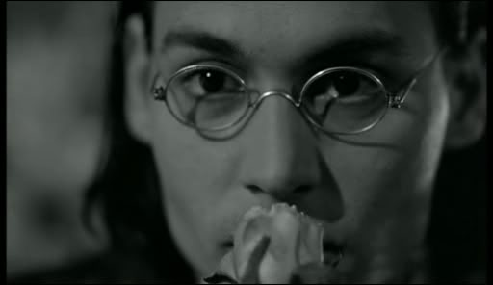
Shot Types (Framing and Composition)
Close-Up
used when/for:
show detail and emotion; dramatic effect

Slide 10
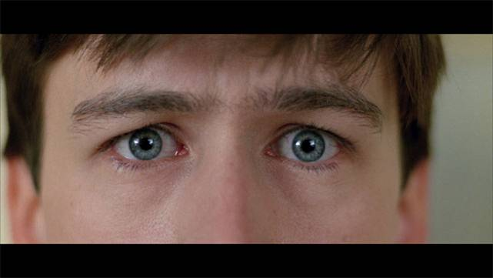
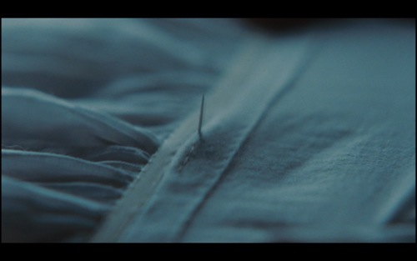
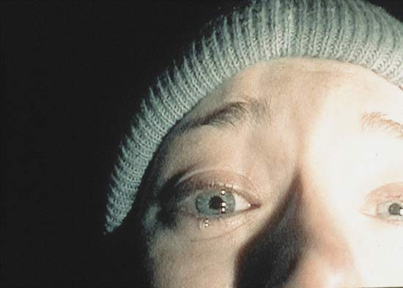
Shot Types (Framing and Composition)
Extreme Close-Up
used when/for:
looking at small detail; intense and/or evoke anxiety

Slide 11
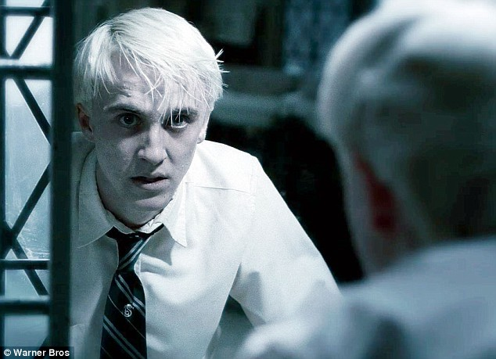
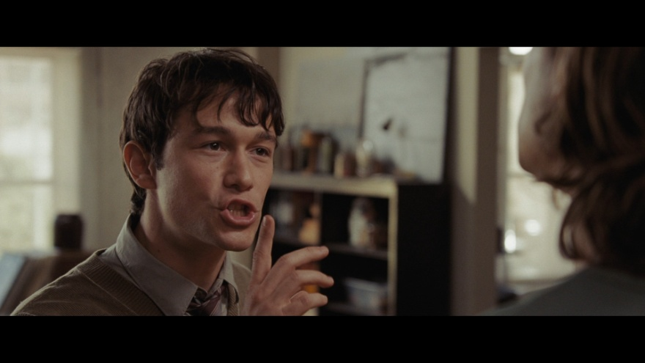
Shot Types (Framing and Composition)
Over the shoulder shot
used when/for:
establish position of each person; feeling of looking at person from the other's pov; common for conversations

Slide 12
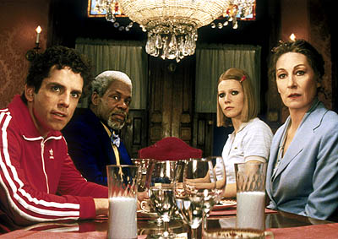
Shot Types (Framing and Composition)
Point of View Shot (subjective shot)
used when/for:
as if seeing through the character (BB)

Slide 13
Framing and Composition: Camera Angles
eye-level
high angle
low angle
dutch angle/tilt

Slide 14
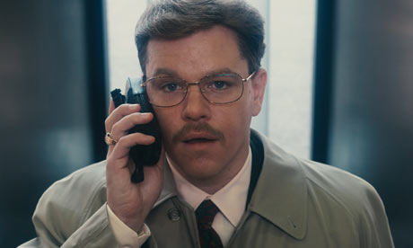
Camera Angles (Framing and Composition)
Eye-Level (straight angle)
used when/for:
most natural; majority of shots; attitude toward subject is neutral (used early in films)

Slide 15
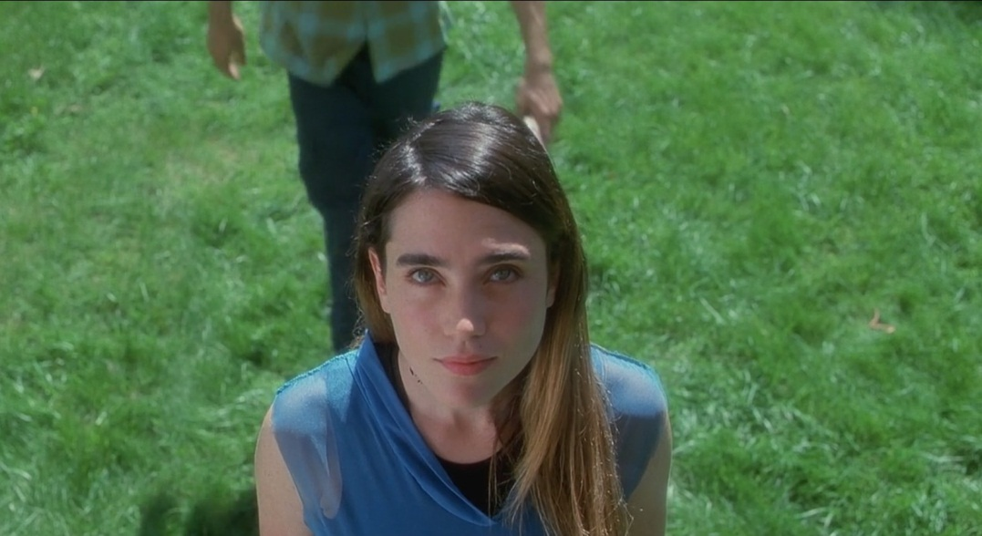
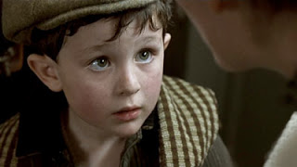
Camera Angles (Framing and Composition)
High Angle
Used when/for:
shows weakness, vulnerability, less authority

Slide 16
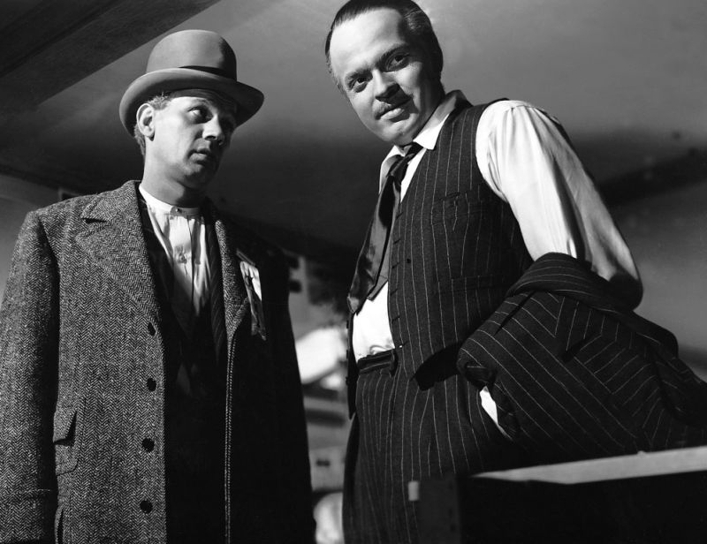
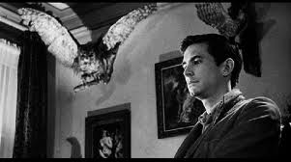
Camera Angles (Framing and Composition)
Low Angle
used when/for:
subject appears larger than life; importance…

Slide 17
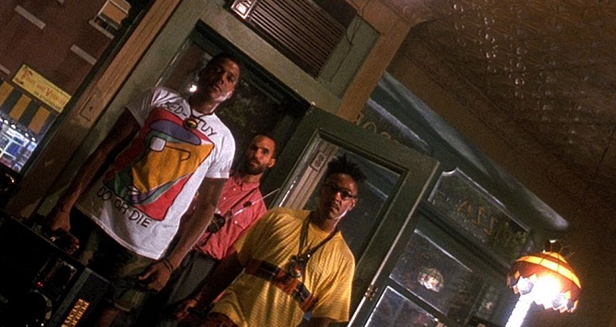
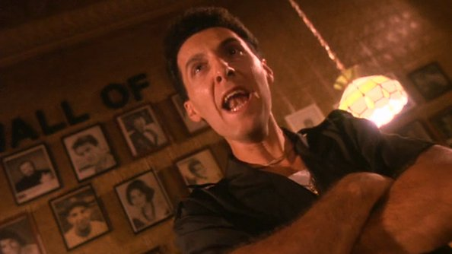
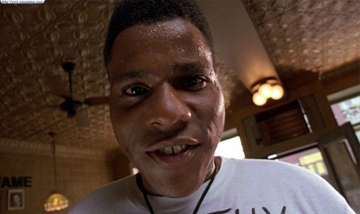
Camera Angles (Framing and Composition)
Dutch Tilt
used when/for:
world is not right/out of balance…

Slide 18
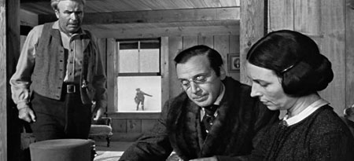
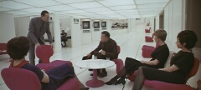
Framing and Composition: “Depth”
Challenge: how to give the illusion of depth
deep-focus composition
rule of thirds

Slide 19
Framing and Composition: Director’s Signature
Framing can become a director’s signature
- using the natural framing occurring in objects
Quentin Tarantino – from below/trunk shots
- or direction and perspective
Wes Anderson – from above
Stanley Kubrick – one-point perspective

Slide 20
Framing and Composition: Camera Movement
Pan
Tilt
Dolly/tracking shots
Crane/“boom”/jib shots
Hand-held and steadicam shots

Slide 21
Camera Movement (Framing and Composition)
Pan – camera rotates horizontally, side to side
Tilt – camera vertically pivots/rotates up and down
In pans & tilts, camera is in a fixed location, it pivots or rotates
Usually tripod mounted
example

Slide 22
Camera Movement (Framing and Composition)
Dolly/tracking shots
Crane/“boom”/jib shots
Hand-held and Steadicam shots
The camera is mobile

Slide 23
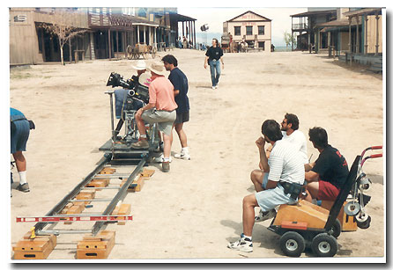
Framing and Composition: Camera Movement
Dolly/tracking shot: camera fixed to wheeled support
dolly in:
frequently used when a character realizes something/comes to a decision
dolly out:
used for slow disclosure
True Detective
Spike Lee - dolly
Wes Anderson

Slide 24
Framing and Composition: Camera Movement
Boom/jib shots: Camera mounted on counterweighted boom
some telescope in or out
can use for pans & tilts
Crane shots: similar look to boom shot
but motorized/hydraulics for movement
typically long or extremely long shots and long takes

Slide 25
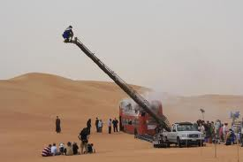
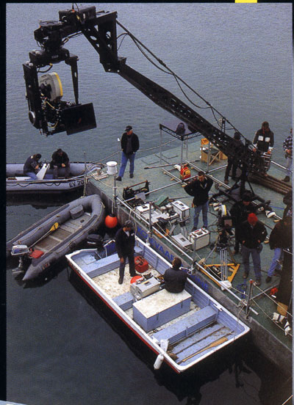
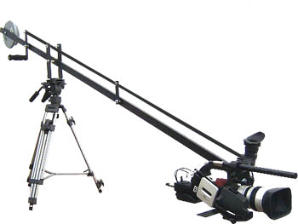
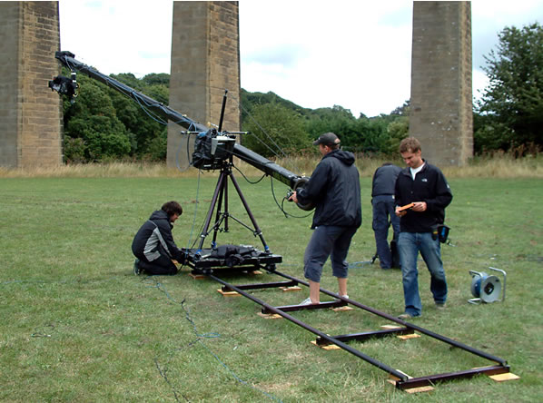
Framing and Composition: Camera Movement
Crane and boom shots…
Opening of Touch of Evil
Opening of The Player

Slide 26
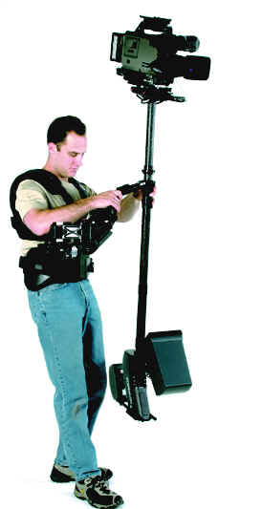
Framing and Composition: Camera Movement
Hand-held and Steadicam shots
can pan, tilt, or track
Hand-held
movement is obviously “unsteady”--which is how we know it’s a hand-held shot
Steadicam
a patented device that steadies camera, producing a relatively smooth movement, even when walking or running
Steadicam first used in Rocky (1976)

Slide 27
Framing and Composition: Camera Movement
Steadicam
Handheld (BV)

Slide 28
Framing and Composition: Camera Movement
The Zoom
camera doesn’t move, but frame changes as the lens focal length is changed
zoom in or out/magnification

Slide 29
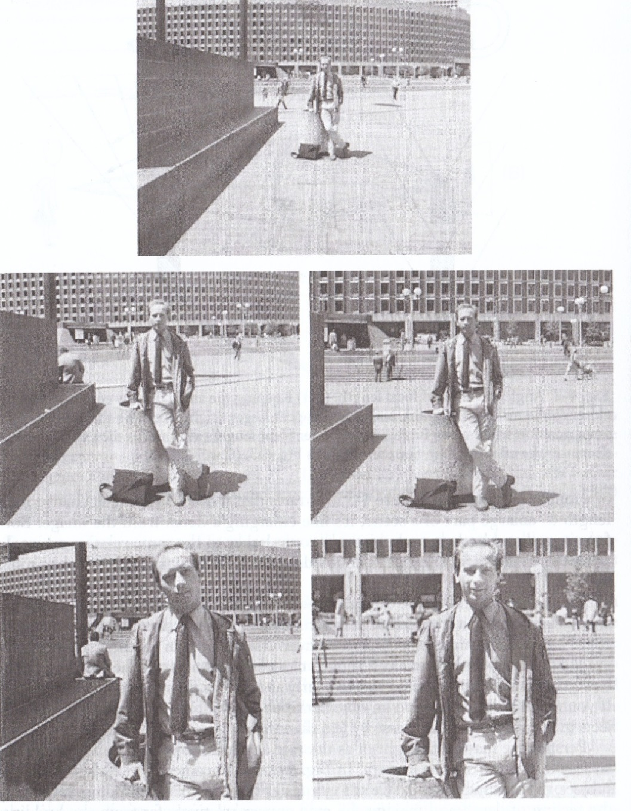
Dolly/Tracking v. Zooming
Explained

Slide 30
Dolly/Tracking v. Zooming
Left (dolly/tracking):
Camera moves
Relation of back/foreground changes
distortion at edges
Right (zoom):
Camera stationary
Change of focal length
Relation of back/foreground (flattening)
Zooming tends to be less natural
ex: re-inact ex: rock ex: street

Slide 31
Framing and Composition: Camera Movement
And there are endless combinations…
Jaws, etc. (1:20)
Now you see it

Slide 32
Framing and Composition: Aspect Ratio (ratio of width to height)
Rules of the Game, Jean Renoir, 1939
1.33:1
Aliens, James Cameron, 1986
1.85:1
Rebel Without A Cause, Nicholas Ray, 1955
2.35:1 (Cinemascope)

Slide 33
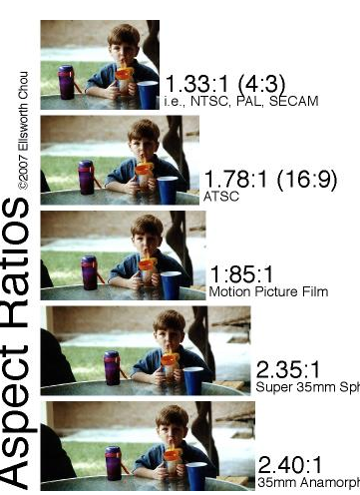
Aspect Ratio
Explanation
EG: now you see it

